Slide 1
CSML1010 – Independent Learning Presentation
Patrick Osborne
Instructor – Dr. En-Shiun Annie Lee

Slide 2

Overview
Benefits and Drawbacks of Accelerating Machine/Deep Learning using non-CPU hardware (GPUs, Tensor Processing Units, Computing Clusters, etc.)
GPU Acceleration
Tensor Processing Unit
(TPU) Acceleration
Distributed/Cloud Computing

Slide 3
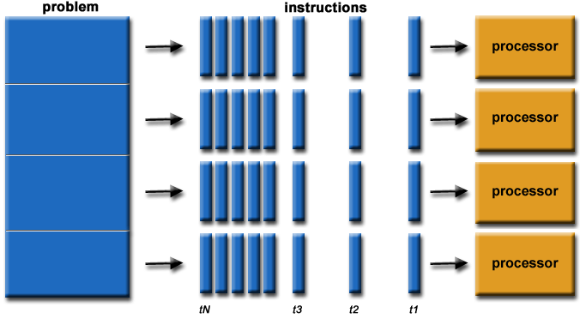
Overview
Optimizing Machine Learning/Deep Learning in general
Mostly performing the same operation on multiple sets of data
Operations like this are easy to run in parallel (“embarrassingly parallel”)
If running on many different, optimized processors, speed up can be many orders of magnitude

Slide 4
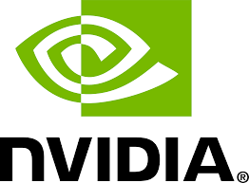
GPU Acceleration
Utilizing fundamentally different
GPU architecture
Extensive parallel processing ability
Hundreds/thousands of individual “stream processors”

Slide 5
GPU Acceleration
Libraries written specifically for GPUs
NVIDIA RAPIDS (set of open-source libraries that aim to reproduce traditional ML functionality)
cuDF: dataframes (pandas equivalent)
cuML: machine learning models and functions (SciKit-Learn equivalent)
TensorFlow
Sometime as simple as with tf.device('/device:GPU:1’):
Other times, need to re-write entire libraries

Slide 6
GPU Acceleration
Existing libraries with a GPU implementation
TensorFlow
Sometime as simple as with tf.device('/device:GPU:1’):
Other times, need to re-write entire libraries

Slide 7
GPU Acceleration
Benefits
Huge speed increases and parallel processing ability
For some cases, easy to implement
Downsides
Existing code cannot always be re-used
Challenges in copying back and forth between GPU memory
Mix of GPU execution and CPU execution can still bottleneck your code

Slide 8
References:
https://towardsdatascience.com/how-to-use-gpus-for-machine-learning-with-the-new-nvidia-data-science-workstation-64ef37460fa0
https://www.tensorflow.org/guide/gpu
https://www.quora.com/How-do-GPUs-accelerate-machine-learning-algorithms

Slide 9
Thank You!

